Slide 1
MY LIFE

Slide 2
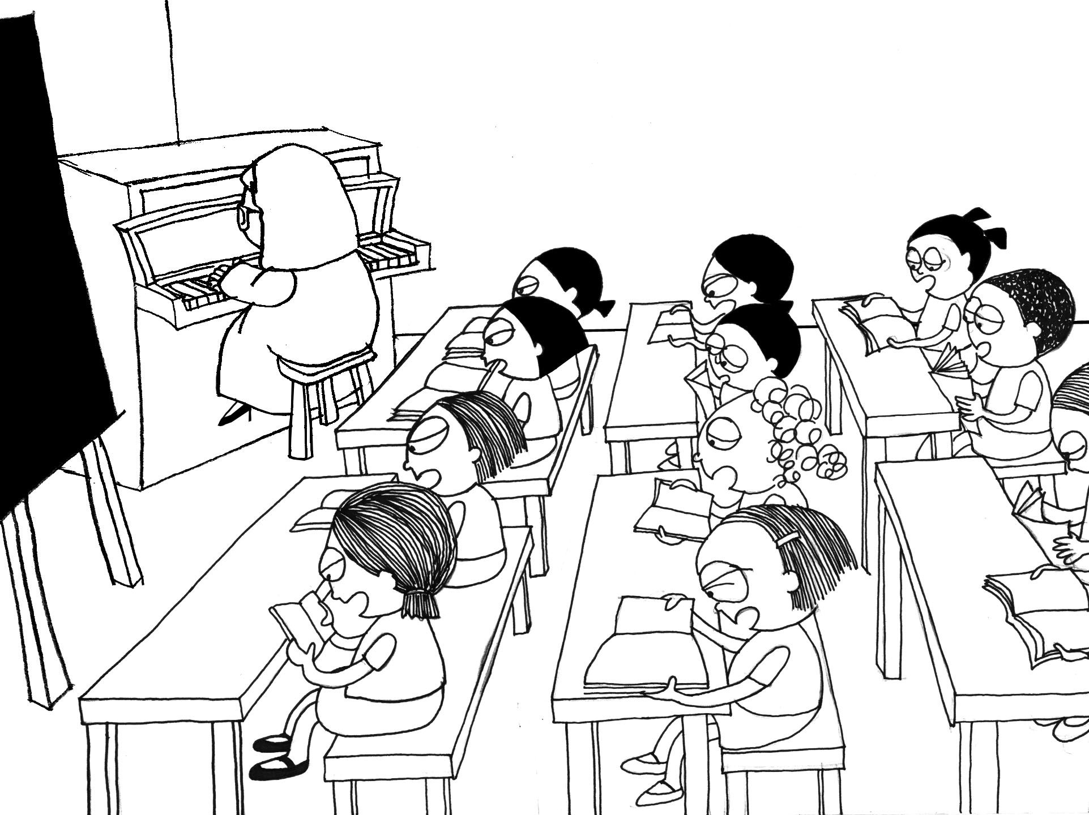
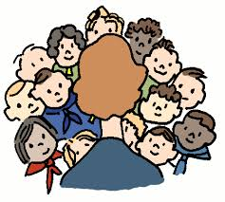
Me
Name: Dominik
Surname: Briševac
Age: 13
Class: 7.b

Slide 3
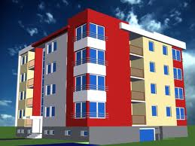
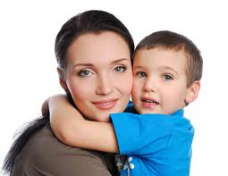
Where I live?
Velikopoljska 24 A,Zagreb,Croatia
Who lives with me?
Me and mum.

Slide 4
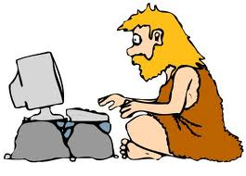
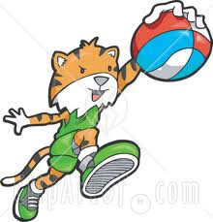
Favorite school subject
History and PE…

Slide 5
Favorite books
Koko in Paris

Slide 6
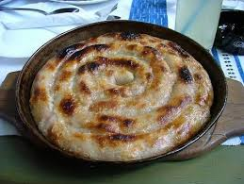
Favorite food and juice
Burek with meat..
Schweppes

Slide 7
Dominik Briševac 7.B
End

